Slide 1

Day 1 Mission Possible

Slide 2

Mission Impossible
Assume we got some log data
two data streams: x, y
each containing a stream of 1000 numbers
Mission #1
Analyze this data:
plot data
calculating statistical numbers like
mean value
standard deviations
correlation coefficient.

Slide 3
Create Test Data
Some Test Data
>> log = randn(1000,2); % boring test data
Non Boring Test Data
>> rng('default'); % reset random generator
>> log = ones(1000,1)*randn(1,2) + randn(1000,2)*randn(2,2)
log =
-1.7813 1.8336
1.7186 1.2289
0.6787 2.2148
-0.6088 1.4329
0.4465 1.1098
0.7128 2.1951
: :

Slide 4
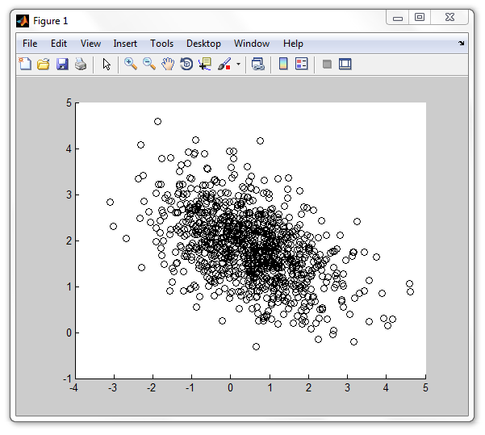
Draw Scatter Plot
>> x = log(:,1); y = log(:,2);
>> scatter(x,y,'k') % black scatter plot

Slide 5
Calculate Statistical Quantities
Mean Value
>> m = mean([x y]) % mean value
m =
0.4857 1.8666
Standard Deviation
>> s = std([x y]) % standard deviation (sigma)
s =
1.1480 0.7454
Correlation Coefficient
>> c = corrcoef(x,y)
c =
1.0000 -0.4803
-0.4803 1.0000

Slide 6
Calculate Statistical Quantities
Mean Value
>> m = mean([x y]) % mean value
m =
0.4857 1.8666
Standard Deviation
>> s = std([x y]) % standard deviation (sigma)
s =
1.1480 0.7454
Correlation Coefficient
>> c = corrcoef(x,y)
c =
1.0000 -0.4803
-0.4803 1.0000

Slide 7
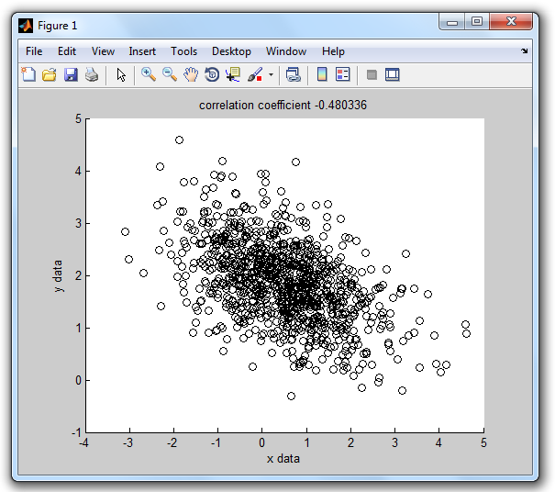
Scatter Plot with Labels
>> figure % open new figure
>> scatter(x,y,'k')
>> xlabel('x data');
>> ylabel('y data');
>> title(sprintf('correlation coefficient %g',c(1,2)));

Slide 8
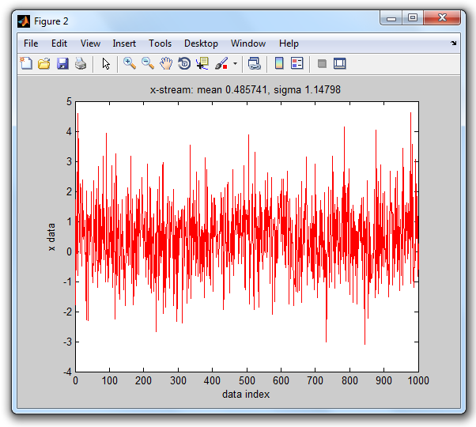
Plot X-Stream with Labels
>> figure % open new figure
>> plot(x,'r');
>> xlabel('data index');
>> ylabel('x data');
>> title(sprintf('x-stream: mean %g, sigma %g',m(1),s(1)));

Slide 9
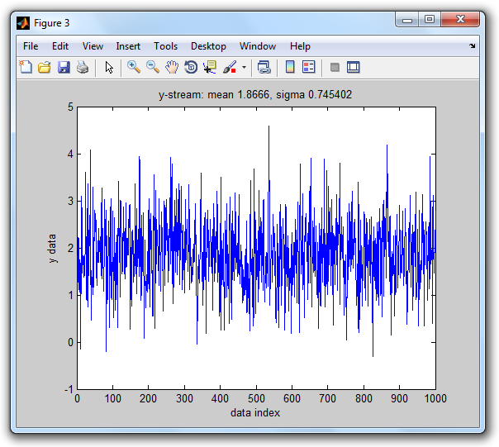
Plot X-Stream with Labels
>> figure % open new figure
>> plot(y,‘b');
>> xlabel('data index');
>> ylabel(‘y data');
>> title(sprintf(‘y-stream: mean %g, sigma %g',m(2),s(2)));

Slide 10

Plot X-Stream with Labels
Mission #1 completed
data creation
comand line plotting / labeling

Slide 11

Mission Impossible
Mission #2
Provide an easy-to-use MATLAB tool
Allows any user to analyse a given data log file ^{*)}
provide 3 plots with proper labeling (same as we did in mission #1)
*) any user who received short instructions

Slide 12
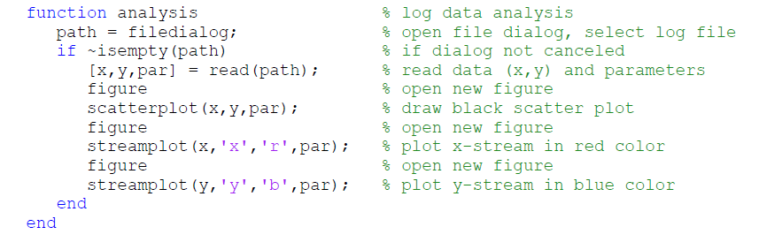
Write a MATLAB Function
Write an M-File Function (which could look as follows)

Slide 13
Organizing Files
We have
log data files
function files (M-file functions)
class methods
Put in a project directory with version folders
imec
imec/log
imec/v1a

Slide 14
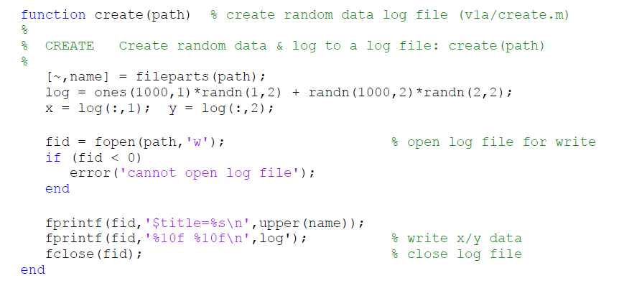
Creating Log Data Files
log data file shall begin with a parameter definition (title of our log data)
syntax: ‘$‘ <parameter> ‘=‘ <value>

Slide 15
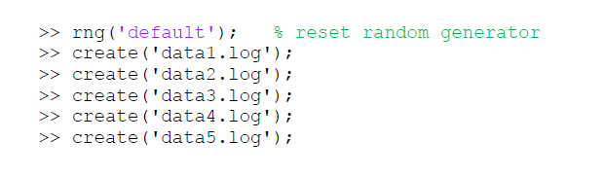
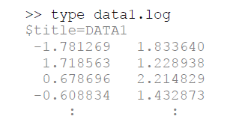
Actual Log Data Creation
Type in command line
We get a log data file like:

Slide 16
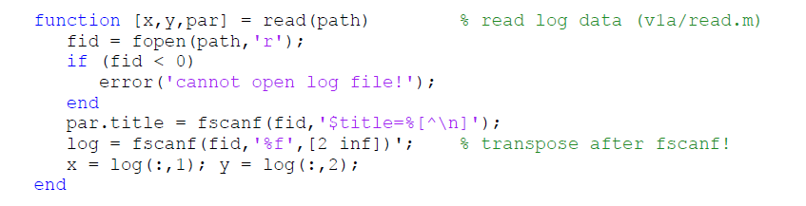

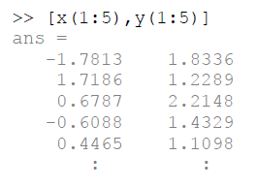

Reading Log Data
Function to read log data into variables x, y & par
We get a log data file like:

Slide 17
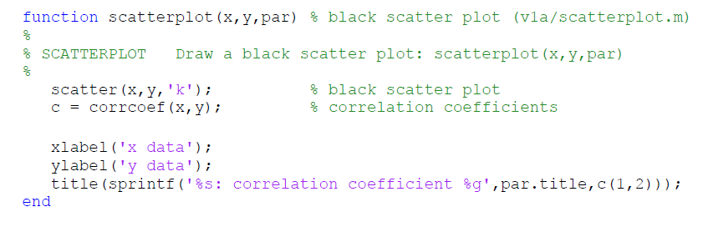
Scatter Plot
Function to draw scatter plot with labeling
We get a log data file like:

Slide 18
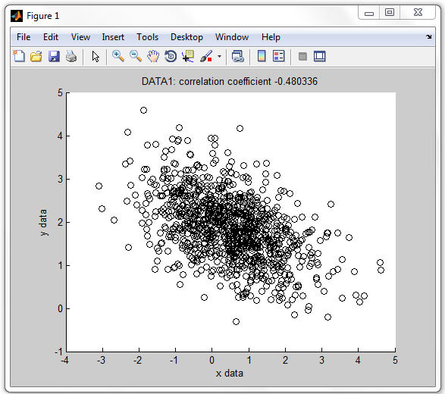

Testing Scatter Plot
How to test

Slide 19
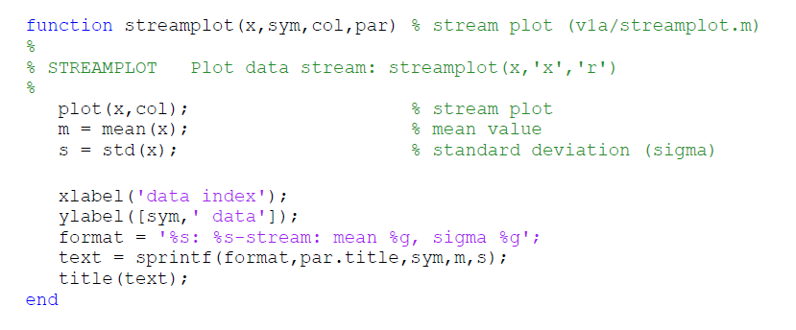
Stream Plot
Function to draw x/y-stream with labeling
We get a log data file like:

Slide 20
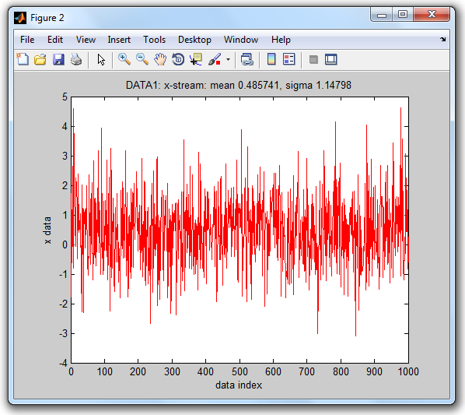
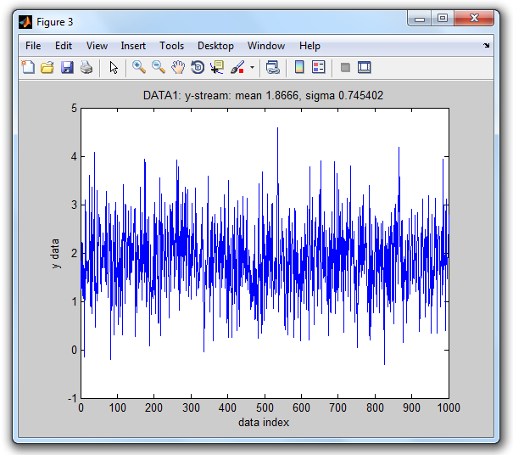

Testing Stream Plot
How to test

Slide 21
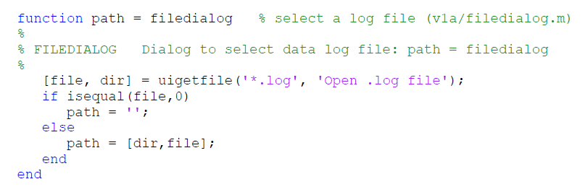

File Dialog
Function to open a file dialog
How to test

Slide 22
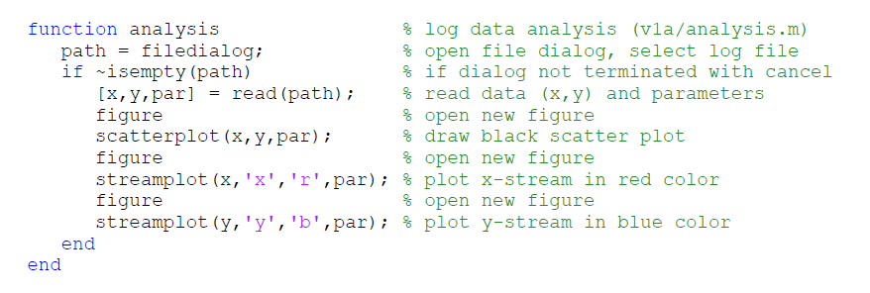

Our Analysis Function
Everything is ready now
all building blocks are available now
we can call our building blocks in our ANALYSIS function
How to test

Slide 23

Awesome
Mission #2 completed
MATLAB function (tool)
Can select any log data file
Draws scatter and stream plot
Provides labels with statistical results

Slide 24
Review
What More?
Question #1
What about data encapsulation?
Question #2
What about user interaction?

Slide 25
Data Encapsulation?
Log file
data was initially encapsulated (parameters, data)
After reading from log file
data & parameters are stored in different variables
OK for a few variables/parameters
loosing overview for many log data & variables/parameters

Slide 26
User Interaction?
Limited User Interaction
the only user interaction is a file dialog
there is no other interactiv control by user
Imagine
imagine that instead of 3 graphs we have 20 different graphs and our tool pops-up all of these graphs ...
Wish
menu driven analysis tool
user interaction (GUI)

Slide 27
Procedural Programming
Our programming Style (so far)
... was procedural programming
Data Representation
data is usually represented by variables or fields of a structure
Operations
are typically represented as functions
they take variables/structures as input args
and return modified variables/structures as output args
programs are sequences of function calls (controlled by some control structures)

Slide 28
Object Oriented Programming
Object Oriented Programming Style
typically study a family of applications (say data analysis tools)
Identify patterns (e.g. of data analysis tools)
Determine what components & functionality is used repeatedly and in common
Base Class
define a base class (super class) that the defines the common properties (data elements) and methods (function elements)
Derived Class
used to implement a specific application
uses specific (overloaded) properties & methods

Slide 29
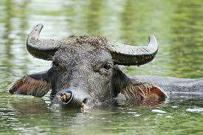
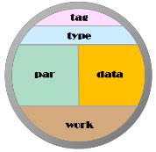
Outlook: Carabao Base Class
object
initialization
menu
construction
check & choice
menus
utilize
menu building block
provide
menu building block
shell settings
&
object options
mass
storage
object
arguments
callback
handling
shell‘s
screen refreshing
shell‘s
menu rebuilding
local function
dispatching

Slide 30
Conclusions
We used a procedural approach to implement a simple data analysis tool
the tool reads data and parameters from a log file, performs calculations on the data (statistical quantities) and plots graphics
the tool does not support user interaction
We see the need for a menu driven tool which supports user interaction
we got an idea how object oriented programming can support basic functionality
we are looking forward to learn more about Carabao class

